Slide 1

Sales Methods Analysis for Pens and Printers' New office Stationery Line
Sergei Bobrik
Analytics department

Slide 2
Background
Pens and Printers, an established provider of quality office products since 1984, is venturing to optimize sales strategies for their new line of creative office stationery that was launched six weeks ago. This line is tailored for “brainstorming activities”, with products such as notebooks, pens, and sticky notes.
Sales team tested three different sales strategies for this:
Email: Customers in this group received an email when the product line was launched, and a further email three weeks later. This required very little work for the team.
Call: Customers in this group were called by a member of the sales team. On average members of the team were on the phone for around thirty minutes per customer.
Email and call: Customers in this group were first sent the product information email, then called a week later by the sales team to talk about their needs and how this new product may support their work. The email required little work from the team, the call was around ten minutes per customer.

Slide 3
Project Overview and Business Goals
Objective & Business Goals :
The sales team seeks analytical insights to present to the executive team with the aim of refining sales tactics for the new product line. The challenge is to determine the most effective sales method – email, call, or a combination of both – based on efficiency and revenue generation. Understanding customer demographics and behaviors associated with each sales method will also be critical for contextualizing the success of the strategies.
Since launching a new product line is expensive, the sales team what to know the following insights:
Customer count for each sales method.
Overall revenue spread and within each sales method.
If there’s a temporal pattern in revenue generation across the different sales methods.
The most effective sales method considering team effort and revenue outcome.
Any distinguishing characteristics of customer groups per sales strategy.

Slide 4
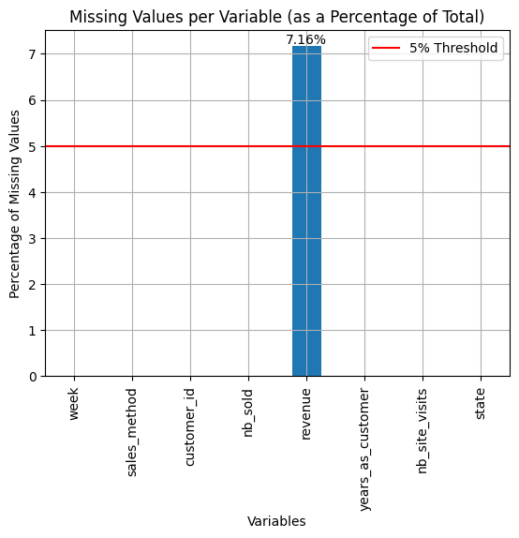
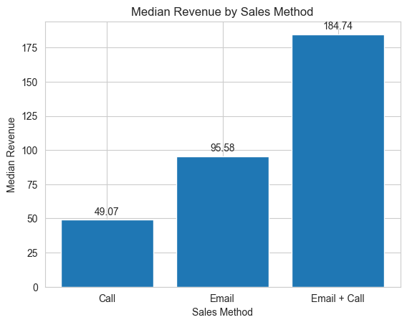
Data validation summary
In ‘sales_method’ column there are 33 entries inconsistent with the predefined categories: 'Email', 'Call', 'Email + Call'
Replaced inconsistent entries with established categories
Revenue Data:1,074 missing values (7.16% of data)
Revenue distribution varies greatly between sales methods + Presence of outliers
Median revenue of the sales method categories used for imputation of missing values
Years as Customer Data
Two records contain incorrect values of more than 40 years
Filter out anomalies for future analysis that will utilize years_as_customer data

Slide 5
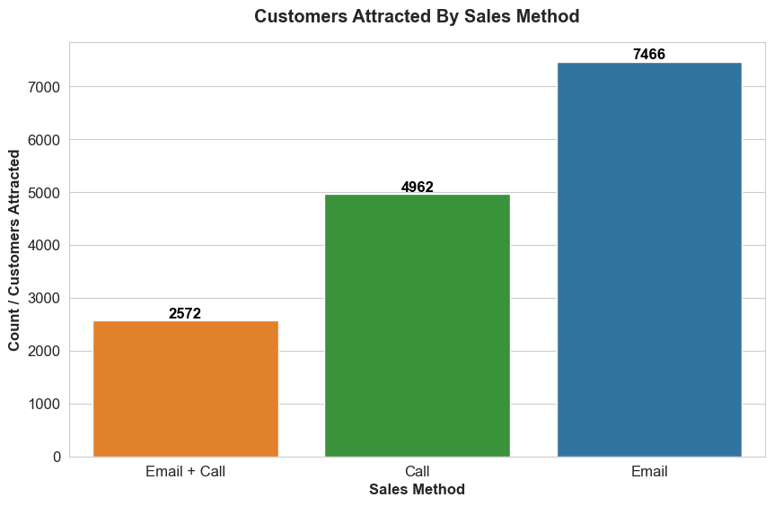
Customers per Approach
Email sales method attracted the highest number of customers
7,466 customers
Call-only method attracted
4,962 customers
Combined approach of email and calls attracted the fewest customers
2,572 customers
Email method required the least effort and yielded the highest number of customers

Slide 6
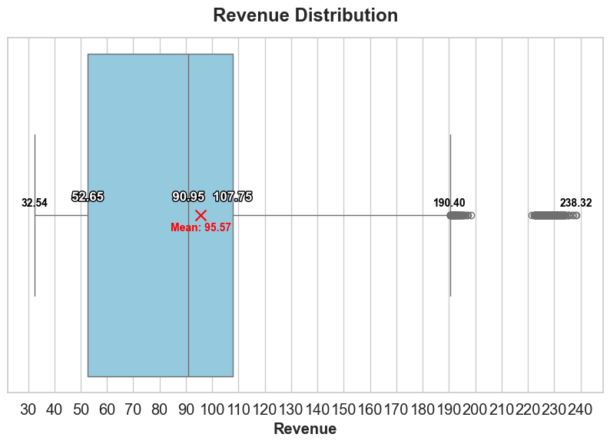
Overall Revenue Spread
Median Revenue: Positioned at 90.95
Half of the sales generated less revenue than this amount and the other half generated more
Mean Revenue: 95.57
Slightly higher than the median, suggesting a distribution with a positive skew
Interquartile Range (IQR):
Between 52.65 and 107.75
The box represents the middle 50% of the revenue values
Whiskers:
32.54 (lower whisker) and 190.40 (upper whisker)
Outliers:
Points beyond the whiskers
A group of outliers near the maximum of 238.32 can be a result of a particularly large, but rare sales or an anomaly
Give a sense of the range of typical values

Slide 7
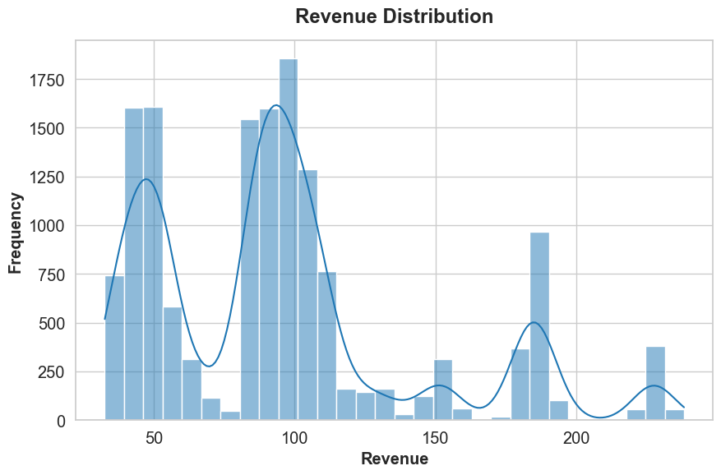

Revenue Spread: Histogram Interpretation
Histogram with kernel density estimate shows multimodal distribution with peaks every ~ 50 units of revenue
Peaks suggest common price points for products sold that result in revenue concentrations
Median number of products sold per each sale is 10, therefore the recurring revenue peaks should correlate with the number of items sold, with a multiplier effect of ten.

Slide 8
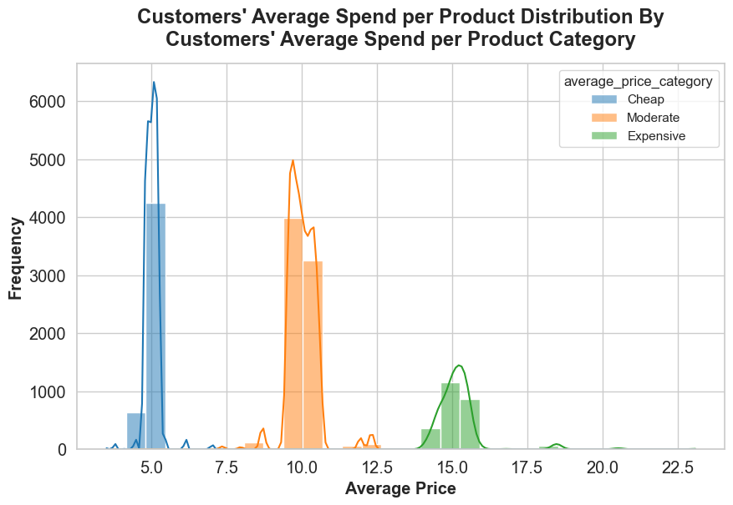
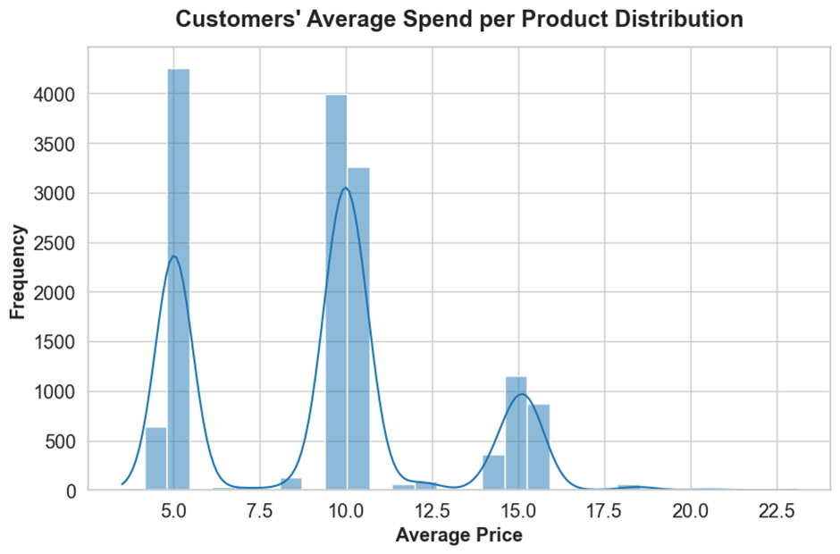
Revenue Spread: Histogram Interpretation
Introduced a column for customers' average price per item sold:
average_price (per sale) = revenue / nb_sold
Histogram shows that the average price tends to peak at units 5, 10 and 15.
Gaussian Kernel Density Estimate (KDE) employed to the average price data to identify the distribution's shape and locate its peaks and troughs.
Segments determined by the troughs in the KDE were used as cut points that naturally segmented the price range into "Customers' Average Spend per Product“ categories: "Cheap", "Moderate", and "Expensive".

Slide 9
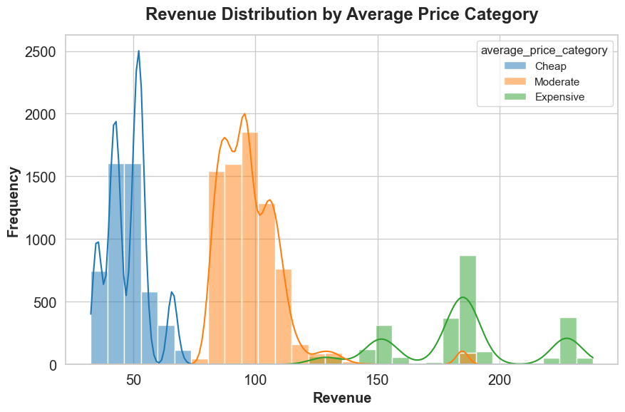
Revenue Spread: Histogram Interpretation
To make it easier, lets call "Customers' Average Spend per Product" as Average Price Category further.
Avg price category | Nr of sales
Moderate | 7560
Cheap | 4963
Expensive | 2477
Majority of sales fell into the "Moderate" price category, followed by "Cheap," and then "Expensive.
This graph offers insights into which price categories are contributing the most to the revenue and helps identify patterns in customer purchasing behavior.

Slide 10
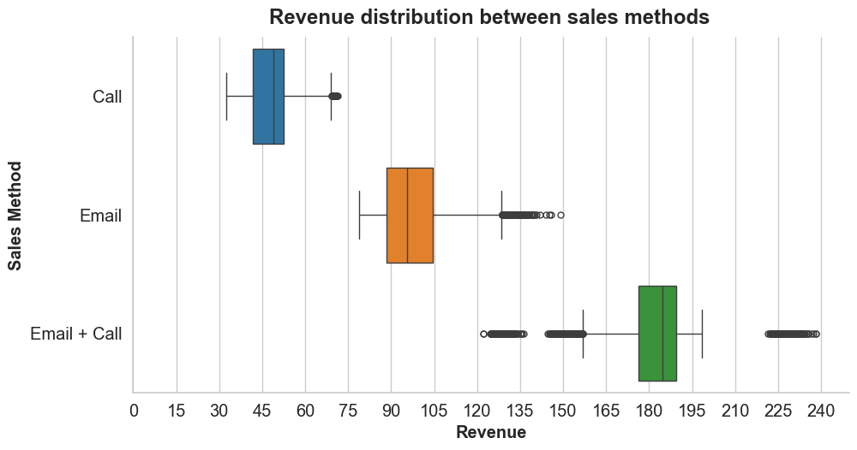
Revenue Spread per Sales Method
Calls: Lower average revenue with consistent distribution
Emails: Wider range and higher average revenue with variability
Email + Call: Highest average revenue with widest range

Slide 11
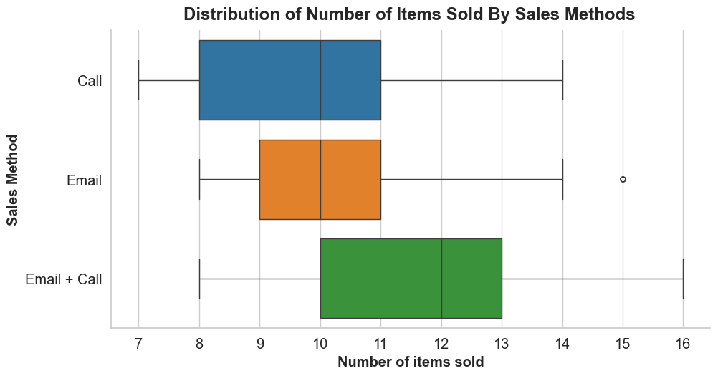
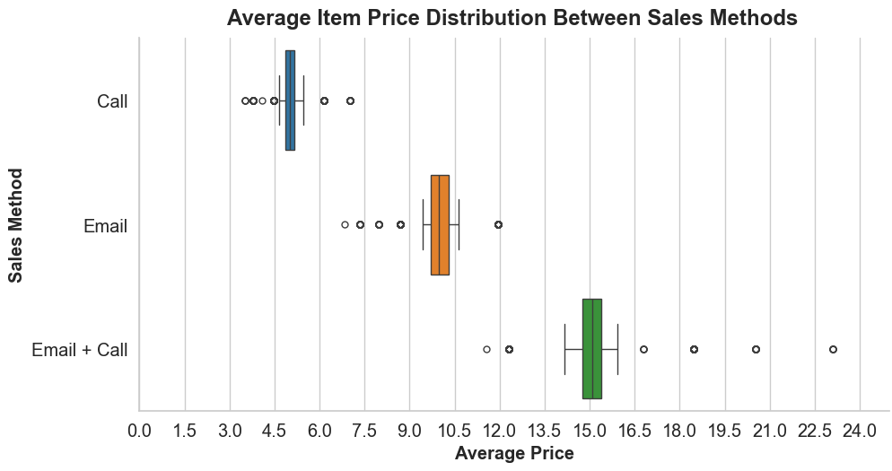
Revenue composites Spread per Sales Method
'Call' method has the potential for higher individual sales and has the lowest median price point, indicating that the items sold through calls tend to be on the more affordable side.
'Email + Call' leads to a bigger number of items sold but introduces a great variability and can command higher prices for items sold.
'Email' method, while not reaching the high numbers seen in the 'Email + Call' method, shows steadiness in sales volume and suggests a moderate pricing strategy.

Slide 12
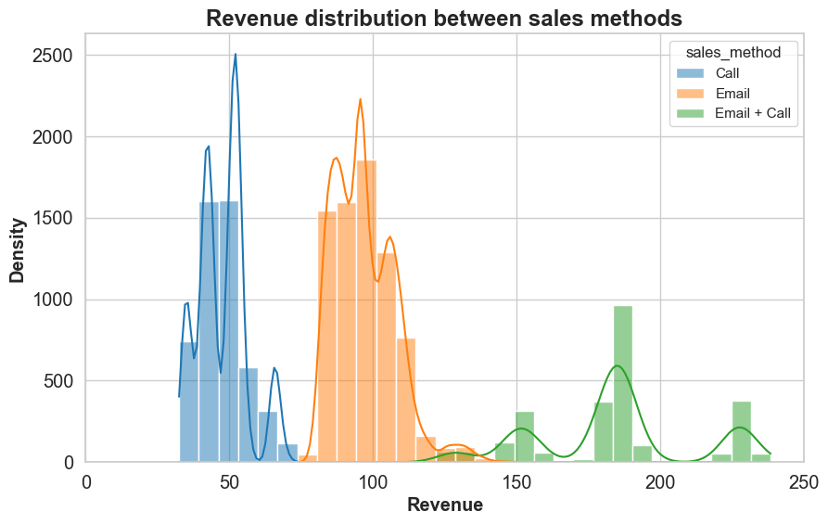
Revenue Spread per Sales Method
Revenue distribution per sales method histogram underlines a pattern that echoes through the previous findings.
We see the multimodal nature of revenue distribution, indicating the existence of common sales amounts that resonate across sales methods.

Slide 13
Revenue distribution per Sales Method Hypothesis
Do specific sales strategies correlate with various "Customers' Average Spend per Product" Categories (do they draw sales of differently priced items)?
Does the distribution of revenue according to sales methods align with the distribution of revenue across different average price categories?
H₀ : The distribution of revenue across sales methods is independent of the average price category of the items sold.
H_{A} : The revenue distribution across sales methods varies with the average price category of items sold.
Considering a 5% significance level

Slide 14
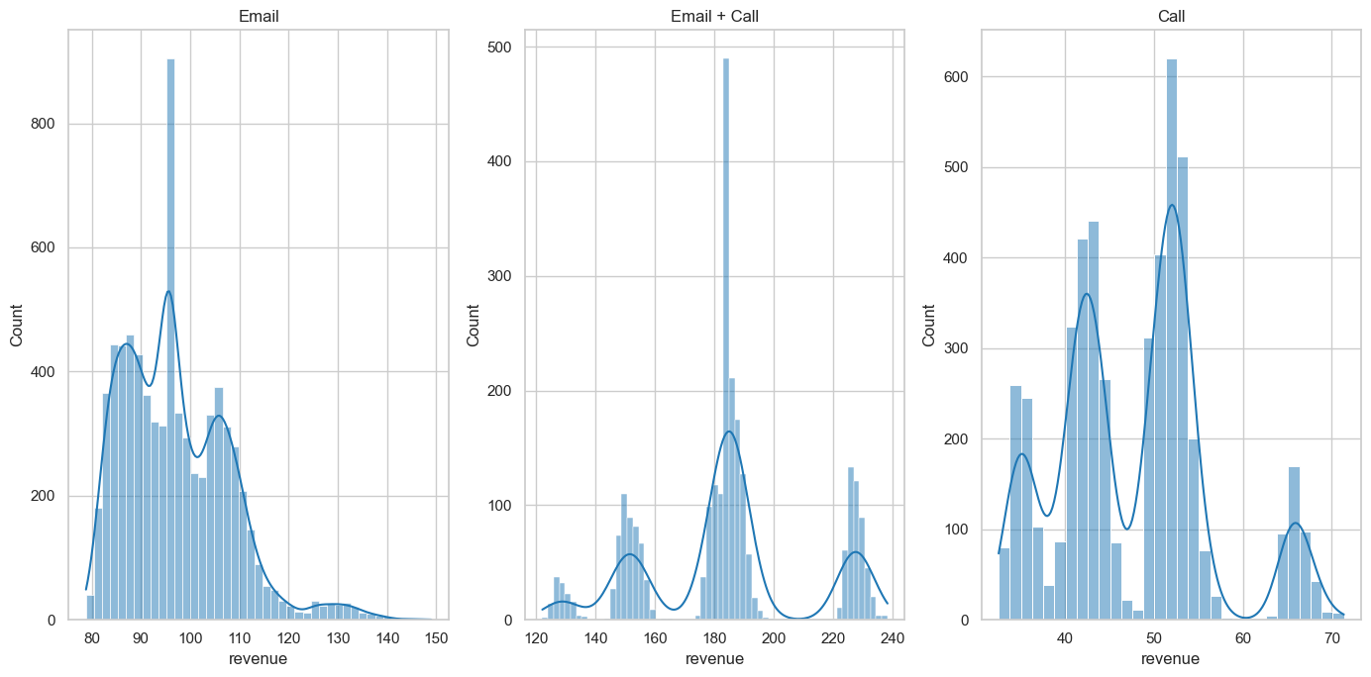
Revenue distribution per Sales Method Hypothesis Test
Revenue distribution within each sales method reveals skewness. Test for equality of variances across the different sales methods indicates a significant difference in variances.
Given that both the normality and homogeneity of variance assumptions are violated, we can use the Kruskal-Wallis, which is a non-parametric "version of ANOVA“ test.
The Kruskal-Wallis results show a significant difference in revenue distributions across the different sales methods, with a p-value much less than the 0.05 threshold.
This suggests that at least one sales method's revenue distribution is significantly different from the others.
Considering a 5% significance level
Levene's Test for equality
of variances results:
statistic=1390.058629087539,
pvalue=0.0
Kruskal-Wallis H-test results:
statistic=12523.25385046208,
pvalue=0.0

Slide 15
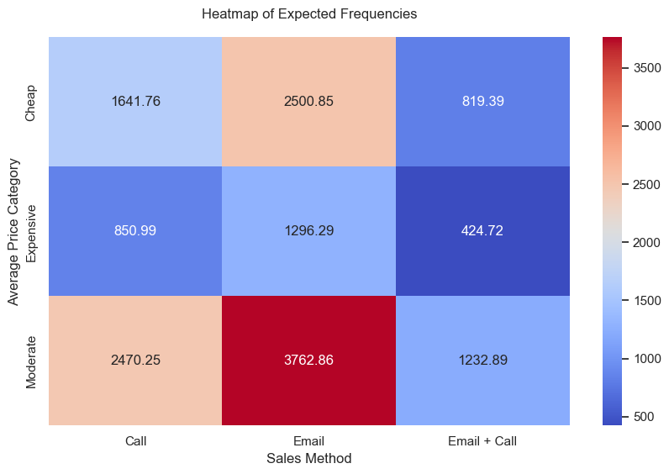
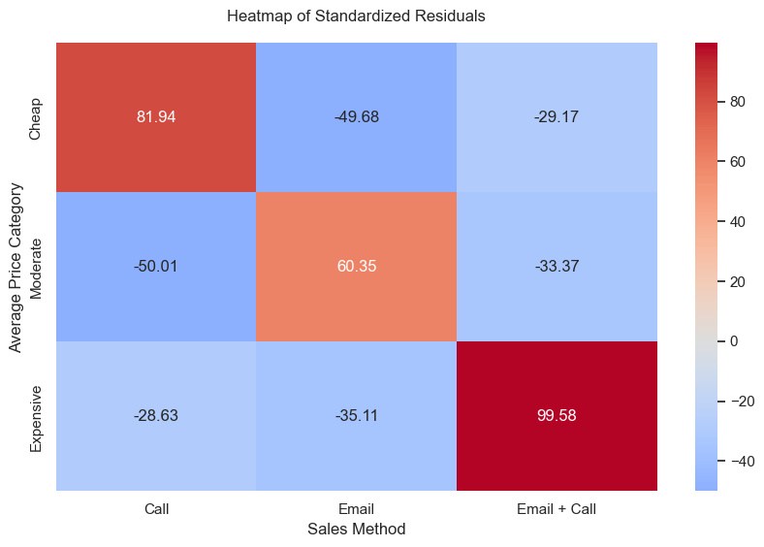
Revenue distribution per Sales Method Hypothesis Test
chi-squared statistic of approximately 29259.42 and a p-value of 0.0, indicating that there is a statistically significant association between the sales method and the average price category.
In other words, different sales methods seem to attract sales of products at different price points, or vice versa, different average priced goods are associated with different sales approaches.
Frequencies if the two variables were independent:

Slide 16
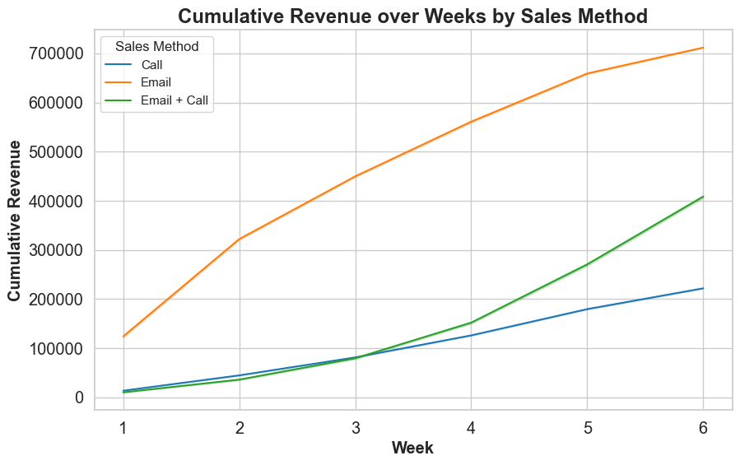
Revenue over Time: Cumulative Revenue
Email method shows consistent and steep increase in revenue over time and almost twice as much cumulative revenue as Email + Call
Suggests a strong uptake of the product from the first week and an effective sales method
Email + Call method also demonstrates an upward trend but with a less steep slope compared to Email alone
Call method shows the slowest growth in cumulative revenue
May build relationships or offer a more personal touch, but does not generate revenue as quickly as the other methods

Slide 17
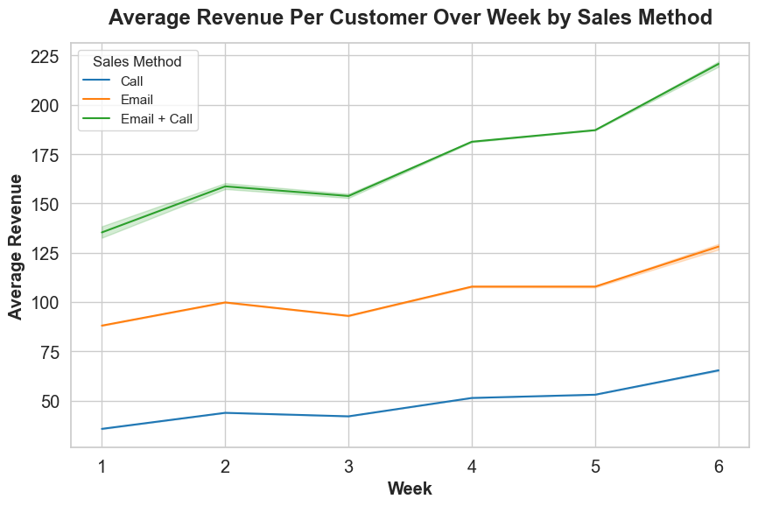
Revenue over Time: Average Weekly Revenue
Email + Call Method
Significant growth in average revenue per sale
Combination of email and call may encourage larger purchases
Email Method
Steady average revenue
Consistent performance in average revenue per sale
Call Method
Lowest average revenue
Slower cumulative revenue growth
Not be as effective in generating higher revenue per sale

Slide 18
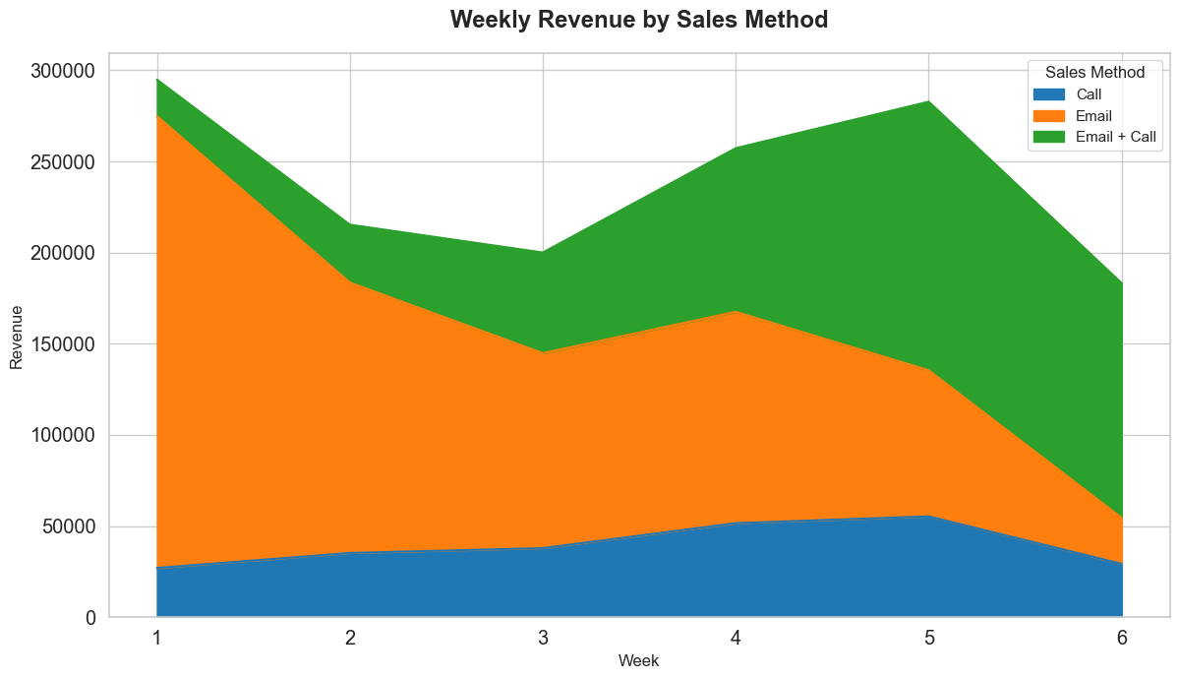
Revenue over Time: Total Weekly Revenue
Email Method
Initially, accounts for the largest share of revenue
Notable increase in the fourth week (second email campaign)
growth decelerates towards the 5’th and 6’th weeks.
Email + Call Method
Maintains a steady growth in revenue contribution
Overtaking 'Email' in the latter half of the period, from the 4’th week onwards
Call Method
Contributing the least to cumulative revenue
maintains a consistent presence without significant fluctuations

Slide 19
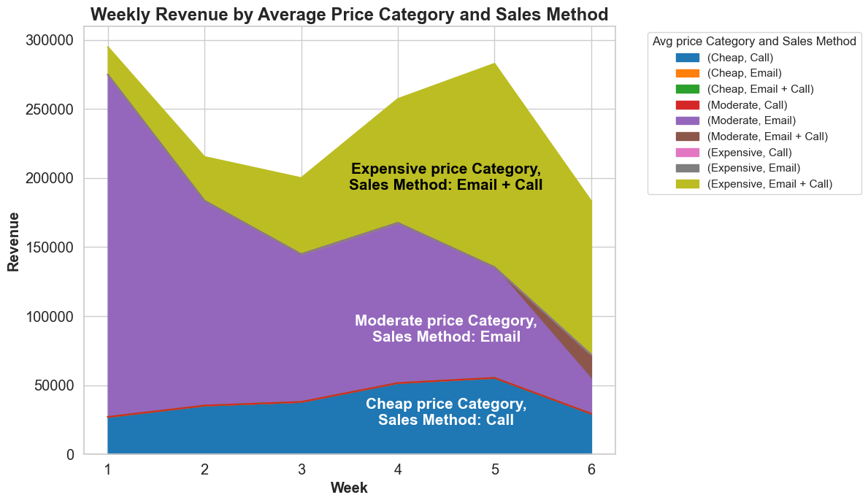
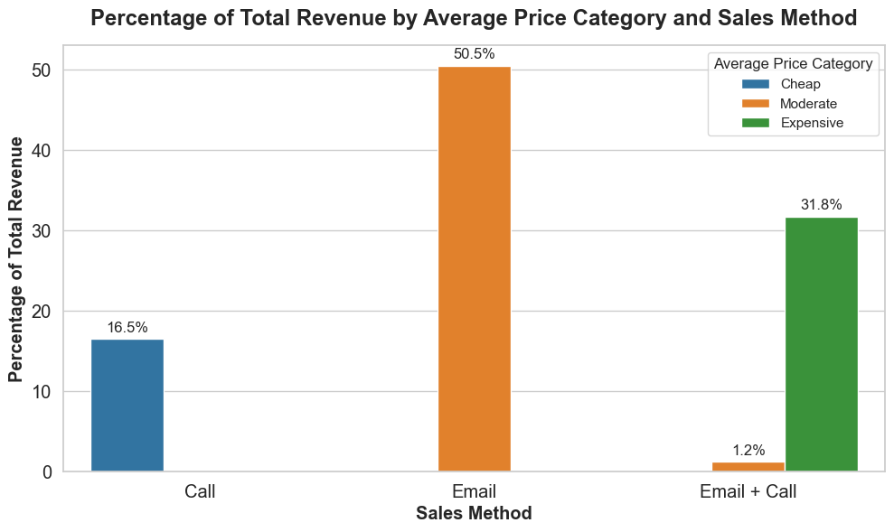
Recommended Sales Method
Expensive price Category: 'Email + Call' method excels
Maximizes revenue from high-ticket items
Shows potential for increased average revenue per week
Secures upwards of 30% of total revenue
Moderately priced goods: 'Email' approach outperforms others
'Email' method contributes to more than half of total revenue
Growth in revenue decelerates towards the fifth and sixth weeks
Offers best revenue-to-effort ratio during past 6 weeks period
Cheap Price Category: 'Call' method prevails
Contributes 16.5% of total revenue

Slide 20
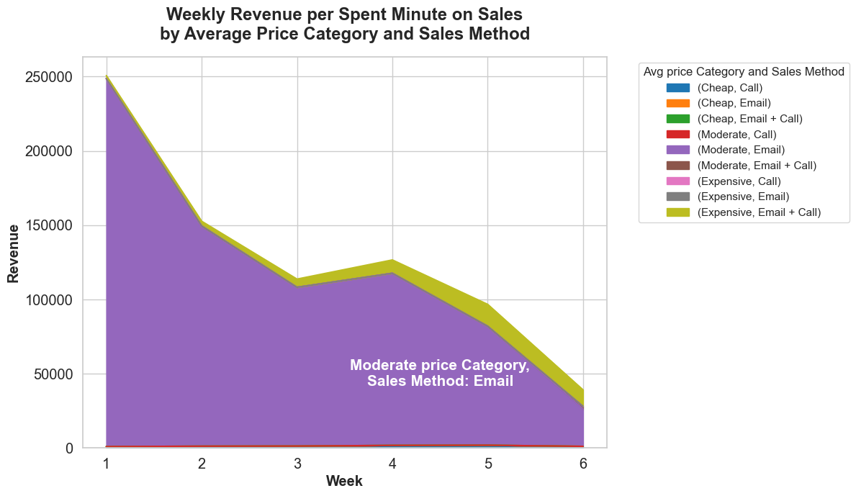
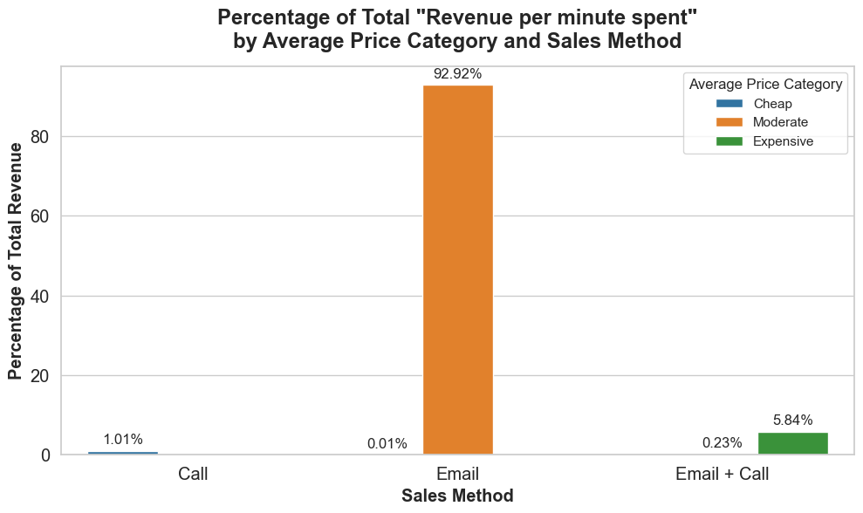
ratio of effort to efficiency
Considering:
Email: Include sending 2 emails & require very little work for the team.
Call: Include 1 call ~ 30 minutes per customer.
Email and call: Include sending 1 email + 1 call ~ ten minutes per customer.
Assuming, it takes approximately 60 minutes to configure CRM emails for a mass delivery session, results in average of 360 milliseconds
I assigned to newly introduced column 'minutes_per_sale’:
30 minutes for call method,
a combination of email time plus 10 minutes of calling time for 'Email + Call’ method
twice the email time for pure emails, (minimum of 1 minute to prevent excessively high revenue per minute calculations)
Then it evaluates revenue generated per minute spent on each sale.

Slide 21
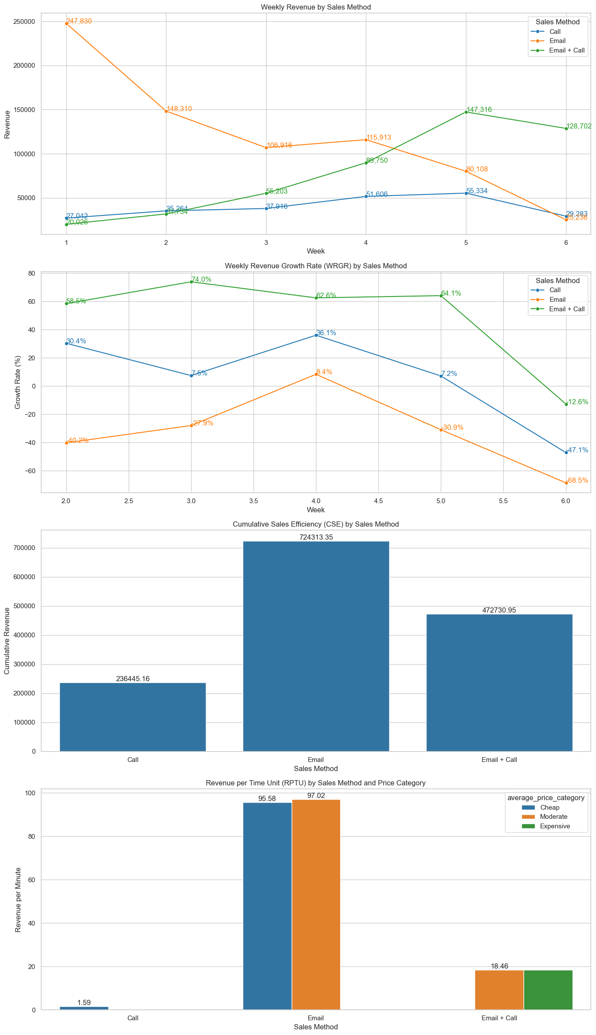
Sales Performance Index: Definition
The SPI will be a comprehensive metric derived from three core components, each representing a dimension of the sales process: weekly revenue trends, cumulative revenue impact, and revenue efficiency based on time spent.
Weekly Revenue Growth Rate (WRGR)
Measures short-term agility and responsiveness of sales method
Calculates week-over-week percentage change in revenue
Cumulative Sales Efficiency (CSE)
Measures long-term strategic value
Evaluates total revenue accrued over a period
Revenue per Time Unit (RPTU)
Assesses operational efficiency of sales method
Compares revenue generated to time invested in sales activities

Slide 22
Sales method | Average price category | Average 3 weeks WRGR | CSE | RPTU | SPI
Email + Call | Expensive | 0.341 | 455180.7 | 18.37 | 0.50
Call | Expensive | 0 | 0 | 0.00 | -0.65
Email | Expensive | 0 | 0 | 0.00 | -0.65
Email | Moderate | -0.304 | 724217.8 | 97.02 | 2.06
Email + Call | Moderate | null | 17550.3 | 18.46 | -0.38
Call | Moderate | 0 | 0 | 0.00 | -0.65
Email | Cheap | null | 95.58 | 95.58 | 0.59
Call | Cheap | -0.012 | 236445.2 | 1.59 | -0.16
Email + Call | Cheap | 0.000 | 0 | 0.00 | -0.65
Data Preparation: Group data by sales method and average price category
Estimate initial value for metric: WRGR as week-over-week percentage change in revenue, CSE by adding up total revenue for each sales method, RPTU by dividing weekly revenue by time spent on sales activities
Focus on average WRGR over the last 3 weeks: reflecting recent trends while smoothing out any single-week anomalies or fluctuations.
Normalization: To ensure a fair comparison across different metrics, we normalize WRGR, CSE, and RPTU (adjust each metric to have a mean of zero and a standard deviation of one)
SPI Calculation: Average the normalized values of 3 weeks WRGR average, CSE, and RPTU for each sales method and price category combination
Sales Performance Index: Calculation Process

Slide 23
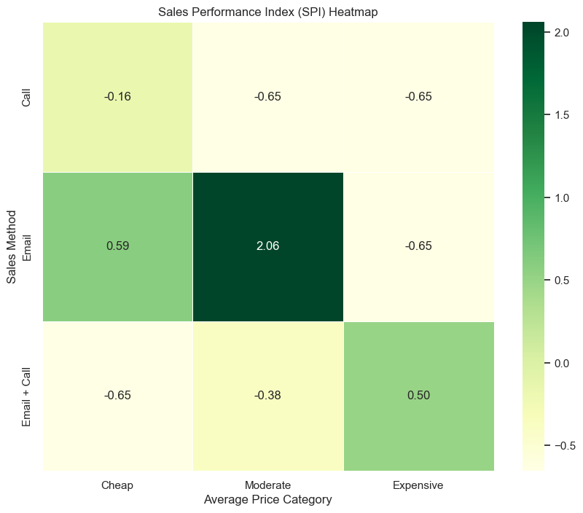
Sales Performance Index: Applying the SPI
Aims to provide a stable measure of short-term sales performance that reflects recent trends and smooths out single-week anomalies or fluctuations
A higher SPI indicates a sales method-category combination that is highly effective and efficient
suggesting that this approach could be prioritized or further optimized for better sales performance.
A lower SPI might reveal areas where improvements are needed
Suggesting de-prioritization of sales method for certain segments
For instance, the "Email + Call" method exhibits a relatively low RPTU but a higher WRGR in recent weeks and a significant share of overall revenue (high CSE), its SPI will account for these factors, potentially ranking it highly for certain price categories.

Slide 24
Differences between Customers
Are there other differences between the customers in each group?

Slide 25
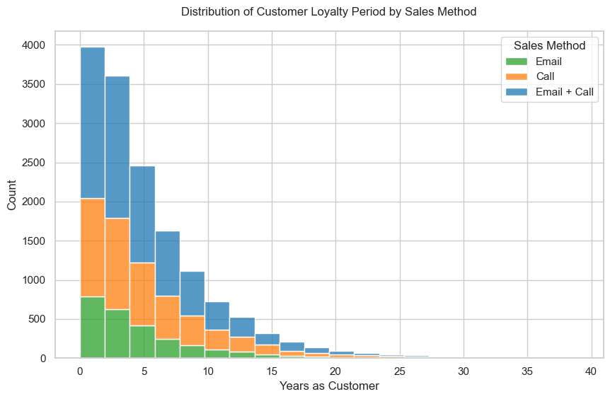
Loyalty Period Distribution
Customer tenure | Nr of customers
0 - 2 years | 5962
5 + years | 4961
2 - 5 years | 4075
Incorrect Value | 2
Significant portion of customer base falls within newer segment
Less than 4 years of engagement
Trend indicates success of recent growth strategies
Email + Call captures almost half of customers
Potential opportunity in fostering long-term relationships

Slide 26
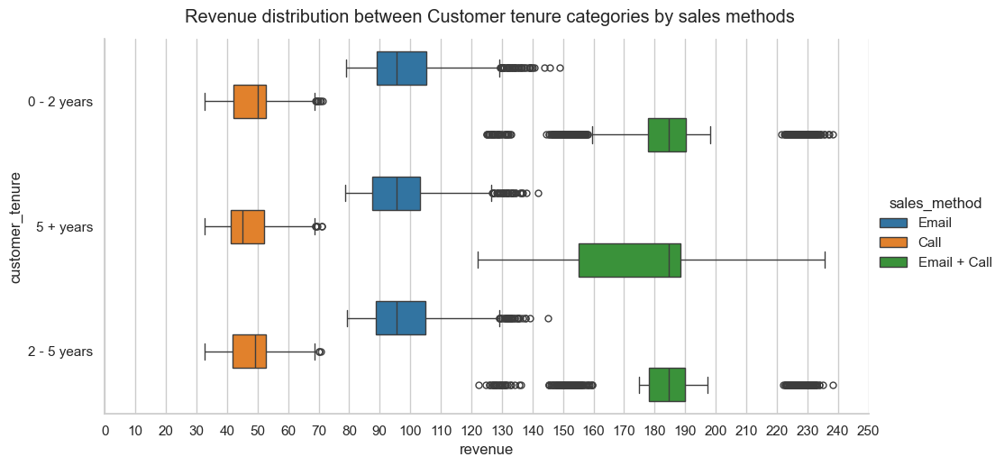
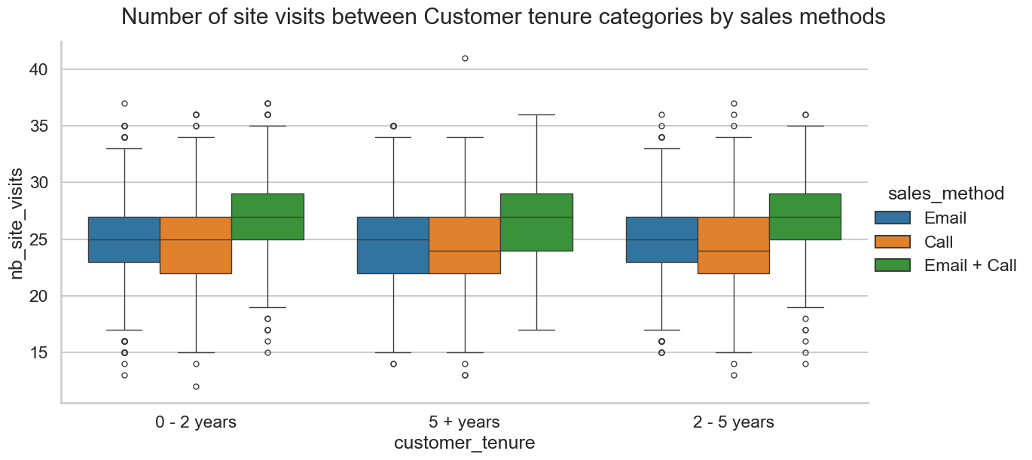
Site Visits by Customer Tenure
Customer Tenure
Revenue Distribution by Customer Tenure
Boxplots suggest similar results for customers of different tenure revenue distribution by sales methods
In the context of site visits, no significant differences in frequency distribution by customer tenure is observed.

Slide 27
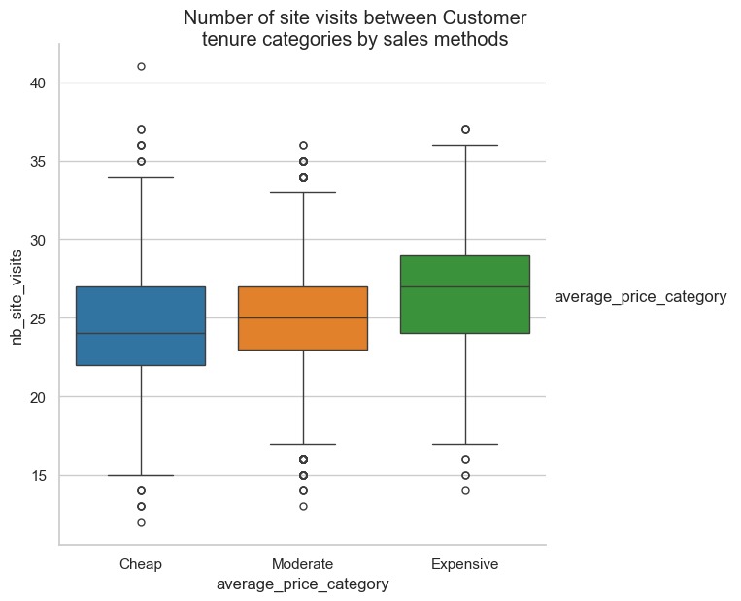
Site Visits by average price categories
However, as seen by the higher median and greater spread in the 'Expensive' category, customers purchasing more expensive items tend to visit the site more frequently

Slide 28
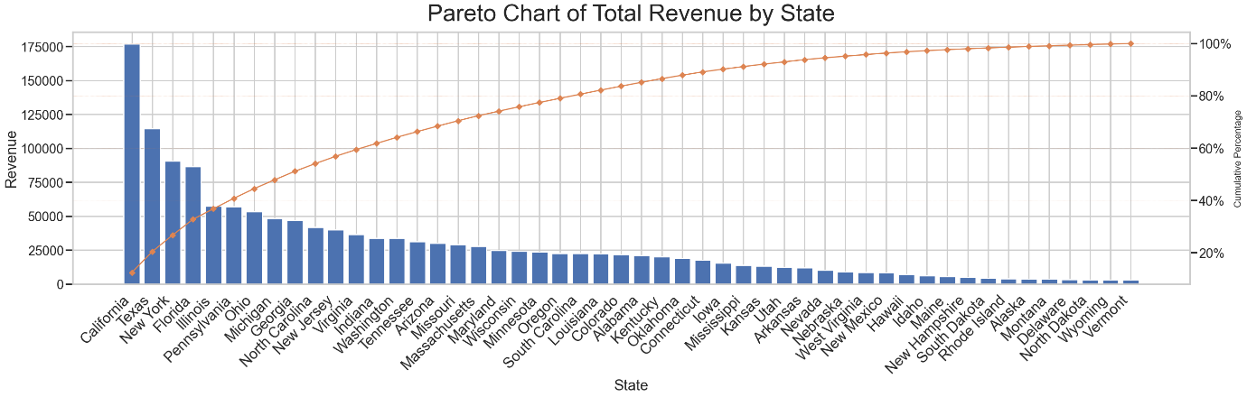
Total Revenue by State
Highlights regional strengths and opportunities for growth
Provides a geographic perspective on sales performance
50% of revenue comes from top 10 states by revenue
Leading states: California, Texas, New York, and Florida

Slide 29
Summary of Findings and Recommendations
Align product strategies with the most effective sales method for each price category:
Maximize the 'Email' Method (strong performance, particularly with moderate-priced items) for future product launches and marketing campaigns.
Prioritize Selective Application of 'Email + Call' Method due to its success with expensive items and potential for high-value sales and growing average revenue per week.
Reassess the 'Call' Method: deprioritize it for revenue generation and focus on building deeper relationships with customers, especially for “cheap-priced” category.
Data-Driven Approach: Continuously monitor the SPI for changes in short-term sales performance.
Customer Segmentation Insights: Significant portion of the customer base is relatively new, highlighting successful recent growth strategies. Retaining these customers, especially through methods like 'Email + Call' for high-value interactions, could enhance customer loyalty and lifetime value.
Geographic and Online Engagement Opportunities: The distribution of revenue by state and the pattern of website visits across different price categories indicate opportunities for targeted marketing and sales initiatives.
Improve data quality: Refine the categorization of sales methods, revenue tracking and correct years as customers that exceed the company's lifespan, consider including information on repeat purchase behavior and specific items bought.

